Slide 1

Auto Code Generation with Machine Learning
Muhammed Salih KALKAN

Slide 2
Introduction
As technology develops in human history, some of the work done with manpower was left to the machines. Automation of production with machines has enabled speed and low cost to be achieved. These machines are usually automated with software. As the software industry developed, software companies sought ways to develop software faster and at lower cost. For this, software plans, software process tracking systems, various software frameworks, easy-to-learn and easy-to-develop software design patterns were developed.
To speed up the software development process, some automated code generation approaches exist. For example, when you want to develop A web application, there are applications that can generate A template code where add-delete-update operations are performed on your models. However, the generation capability of these automatic code generating algorithms is limited. They can only generate code in A very small area defined for them. Machine learning approaches should be applied to improve the code generation capability of such applications. Thus, the area of automatic code generation can be further expanded. This provides speed and low cost in software development. Machines that develop software with machine learning can be called virtual software developers.

Slide 3
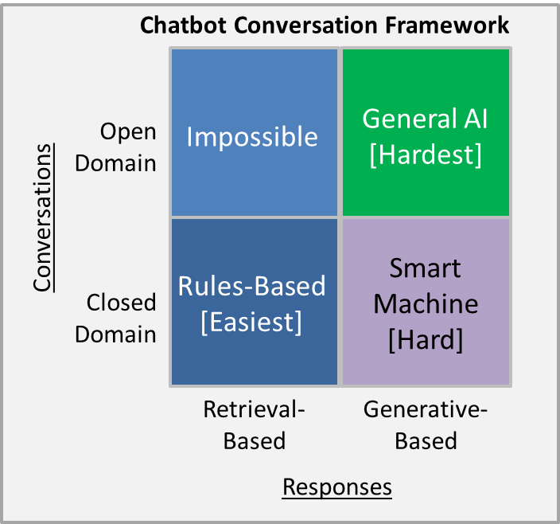
Text in – text out

Slide 4
Problem Statement
Making sense of sentences
Grouping sentences with the same meaning told in different ways under the same tag
Add the A value to the B value.
The code piece is generated!
The A and B values add up.
What do you mean?
Add the A value to the B value.
Tag: Sum of A and B
The A and B values add up.
Tag: Sum of A and B

Slide 5
Problem Statement
Establishing relationships between sentences
Generating new code with previously learned pieces of code
The initial value of A is 5.
The code piece is generated!
The initial value of B is 7.
The code piece is generated!
These two values add up.
Which values?

Slide 6
Related Works
OpenAI Codex (GPT-3 based) (August 10, 2021)
Based on GPT-3, a neural network trained on text, Codex has additionally been trained on 159 gigabytes of Python code from 54 million GitHub repositories. A typical use case of Codex is typing a comment, such as "//compute the moving average of an array for a given window size", then using the AI to suggest a block of code satisfying that prompt. OpenAI has stated that Codex can complete approximately 37% of requests and is meant to make human programming faster rather than replace it.
https://www.youtube.com/watch?v=Zm9B-DvwOgw

Slide 7
Solution
Gives feedback for unfamiliar texts.
Generating Code
User creates new additional dataset based on feedback.
Training with the new additional dataset.

Slide 8
Solution
Text
Text
Text
Modules
Text

Slide 9
Solution
Code as Text
Requirements as Text
Module
Module
Module
Module
Module
Module
Module
Module

Slide 10
Methodology
NLU (Natural Language Understanding) is used for understanding the text.
1. Spelling Correction
2. Tokenization
Requirements as text
Code Modules
3. Part-of-speech Tagging
4. Lemmatization
5. Code Module Generation
6. Code Module Configuration

Slide 11
Methodology
For example, “adding the A valeuu and the B valuuu.”
1) Adding the A value and the B value.
2) Adding – the – A – value – and – the – B – value
3) VBG – DT – NN – NN – CC – DT – NN – NN
4) Add – the – A – value – and – the – B – value
5) Sum of * and * Module
6) Sum of A and B Module

Slide 12
Methodology
A script language is used. Let’s call it Robocode.
Robocode adopts pattern matching approach.
Robocode structures:
Defines: Defines knowledge about programming. For example «Access modifiers can be public, protected and private.»
Code Piece: Correspondes to a piece of real code as text
Code Module: Contains code modules and code pieces
Code Module
Real Code as Text

Slide 13
Methodology
Robocode training set example:
Definer : ProgrammingLanguage
{
-C#
}
Definer : AccessModifier
{
-Public
-Internal
-Protected
-Private
}
Definer : IsStatic
{
-NonStatic
-Static
}

Slide 14
Methodology
C# Create @className Class Module
{
Parameters: [AccessModifier accessModifier, IsStatic isStatic, node[] classContent]
Contents: [<C# Code Piece 1>(className, accessModifier, isStatic); [<content>(); for content in classContent]; <C# Code Piece 2>();]
}
C# Create @methodName Method Module
{
Parameters: [AccessModifier accessModifier, IsStatic isStatic, string returnType, node[] methodContent]
Contents: [<C# Code Piece 3>(methodName, accessModifier, isStatic, returnType); [<content>(); for content in methodContent]; <C# Code Piece 2>();]
}
C# Code Piece 1
{
Parameters: [className, accessModifier, isStatic]
Content: '@accessModifier @isStatic class @className\n {\n'
}
C# Code Piece 2
{
Parameters: []
Content: '}\n'
}
C# Code Piece 3
{
Parameters: [methodName, accessModifier, isStatic, returnType]
Content: '@accessModifier @isStatic @returnType @methodName()\n {\n'
}

Slide 15
CONCLUSION
As a result, our trained algorithm became able to generate code for some scenarios. Since it provides training on file operations and addition-subtraction-multiplication-division operations, our algorithm can develop applications that only require these features. It can produce successful results for all combinations of these requirements. As future work, more training sets should be produced. As the algorithm is trained, it will understand the texts more accurately and will be able to generate codes that meet different demands.

